Slide 1
Latency vs. Throughput

Slide 2
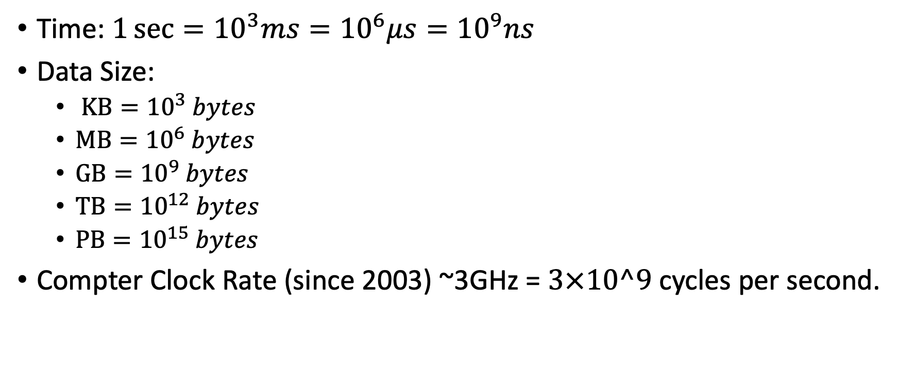
Some numbers
Time: $1\sec{={10}^{3}ms={10}^{6}μs={10}^{9}ns}$
Data Size:
$KB={10}^{3} bytes$
$MB={10}^{6} bytes$
$GB={10}^{9} bytes$
$TB={10}^{12} bytes$
$PB={10}^{15} bytes$
Compter Clock Rate (since 2003) ~3GHz = $3×10^9$ cycles per second.

Slide 3
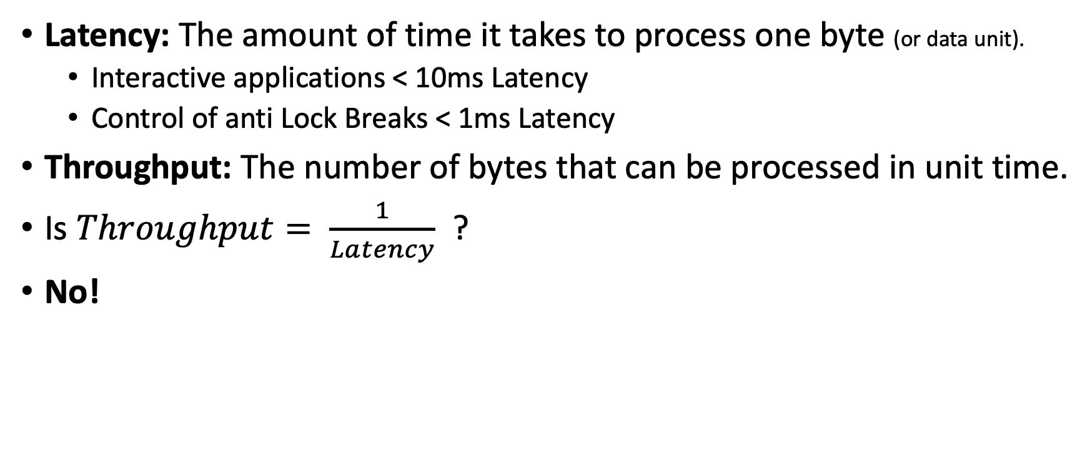
Definitions
Latency: The amount of time it takes to process one byte (or data unit).
Interactive applications < 10ms Latency
Control of anti Lock Breaks < 1ms Latency
Throughput: The number of bytes that can be processed in unit time.
Is $Throughput= \frac{1}{Latency}$ ?
No!

Slide 4

Why $Throughput≠ \frac{1}{Latency}$ ?
Sequential execution
Latency = ½ sec
Throughput = 2 byte/sec
½ sec
CPU 1
byte
byte
byte
byte
byte
Parallel execution
½ sec
byte
byte
byte
byte
byte
Latency = ½ sec
Throughput = 8 byte/sec
CPU 1
CPU 2
byte
byte
byte
byte
byte
CPU 3
byte
byte
byte
byte
byte
CPU 4
byte
byte
byte
byte
byte

Slide 5
Processing in Bulk
The latency for reading a random block from a spinning Disk is 10ms.
Why? Because of the mechanics of moving the reading head.
Instead of reading one byte, read a whole block!
Assuming all of the data in the block is useful:
Latency: 10ms
Throughput: 100MB/sec
Caching: a method for achieving low latency and high throughput by assuming locality.
byte
byte
byte
byte
byte
byte
byte
byte
byte
byte
byte
byte
byte
byte
byte

Slide 6
When do we need low latency?
When interacting with our cell phone or laptop.
When playing games online: https://tetris.com/play-tetris
When viewing very large images (uses tiling technique) https://activebrainatlas.ucsd.edu/
Anything interactive – working on a jupyter notebook.
Running javascript inside a browser
Latency = reaction time < 100ms

Slide 7
When do we need high throughput
When we have a large amount of data to process, we care little about latency, we care about throughput.
Prime example: we have 50TB of data and we want to transfer it to the cloud.
Regular home line: upload speed 6Mbps = 6/8 MBps -> 771 days ~ 2 years
Fast University line: upload speed 100Mbps = 100/8 MBps -> 46 days
Dedicated fiber: upload speed 10Gbps = 10/8 GBps -> 11 hours
Dedicated fiber costs 10-100K$ per year.

Slide 8

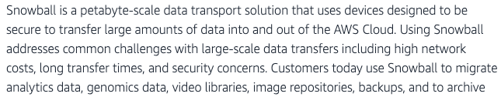
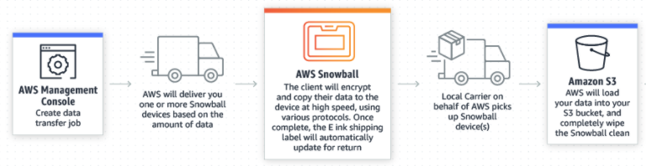
The fast and cheap option: Fedex

Slide 9
Summary
When providing an interactive experience, we care more about latency than throughput.
When processing TB, we care more about throughput than about latency.
Transmitting TB through the internet is slow and expensive.
Sending a physical disk through Fedex is cheap and high bandwidth.

